Slide 1
AUDIO EQUALIZER
BASCDSP Machine project (group #)

Slide 2
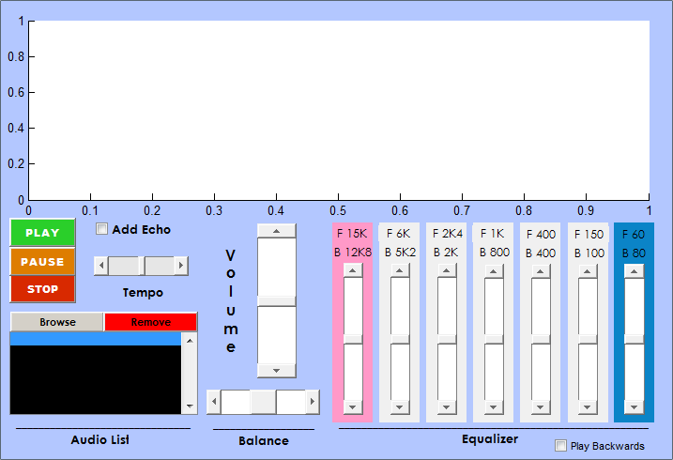
DESIGN

Slide 3
DESIGN
1
2
10
3
9
4
6
7
5
8

Slide 4
SAMPLE RATE
Fs = Standard 44100Hz

Slide 5
Supported File Types
.wav files only

Slide 6
VOLUME
From -40dB to 40dB

Slide 7
EQualizer
From -40dB to 40dB

Slide 8
VARIABLES LIST
<none>

Slide 9
HOW to CALCULATE VOLUME
1.) Get value ‘x’ from the slider.
2.) Convert ‘x’ to decibel value ‘dBx’.
3.) Convert ‘dBx’ to power gain value ‘val’ .
Notable Formulas:
Decibels: dBx = 40*x-40
Decibels to Power Gain: val = 10^(dBx/10)

Slide 10
VARIABLES LIST
val ← for power gain in volume

Slide 11
How to calculate the equalizer GAINS
1.) Get value ‘x[i]’ from the slider.
2.) Convert ‘x[i]’ to decibel value ‘dBx[i]’.
3.) Convert ‘dBx[i]’ to power gain value ‘valeq[i]’ .
4.) Repeat for other (6) equalizers ‘i’
Notable Formulas:
Decibels: dBx = 40*x-40
Decibels to Power Gain: val = 10^(dBx/10)

Slide 12
VARIABLES LIST
val ← for power gain in volume
valeq[] ← for power gain 7 equalizers

Slide 13
How to calculate the equalizer VALUES #1
Set:
Nth order : 100

Slide 14
How to calculate the equalizer VALUES #2
Set:
Low Frequency Cutoff, Fl[i]
Higher Frequency Cutoff, Fh[i]
Cuttoff Frequency: Wn[i] = [ Fl[i] Fh[i] ] / Fs
in every equalizer values

Slide 15
How to calculate the equalizer VALUES #3
Filter Function:
F[i] = fir1(N,Wn[i],'ftype');
,where
N = no. of order
Wn[i] = cuttoff frequency
‘ftype’ = frequency type;

Slide 16
How to calculate the equalizer VALUES #4
Direct Form 2 Filtering:
Hd = dfilt.dffir(F[i])

Slide 17
How to calculate the equalizer VALUES #5
Fixed-point Filter:
data[i] = filter(Hd, y)*valeq[i];
,where
y = original waveform of sound
valeq[i] = gain of each equalizer

Slide 18
How to calculate the equalizer VALUES #6
Add all data[i] to value z
z = data[0]+ data[1]+ data[2]+data[3] +data[4] +data[5]+data[6]

Slide 19
VARIABLES LIST
val ← for power gain in volume
valeq[] ← for power gain 7 equalizers
z ← constructed waveform with filter

Slide 20
HOW TO ADD ECHO
ztemp=z;
N = 4000;
for n=N+1:length(ztemp)
z(n) = z temp(n) + ztemp(n-N);

Slide 21
HOW to set tempo
1.) Get the value ‘tempval’ from the tempo slider
2.) if tempval > 0:
f= f/(A^abs(tempval))
3.) if tempval <0
f = f*(A^tempval)

Slide 22
HOW to set REVERSE PLAY
z=flipud(z);

